Slide 1
Media Coverage
Lahore School of Economics
15th Annual Conference on the Management of the Pakistan Economy held on 27th March 2019

Slide 2
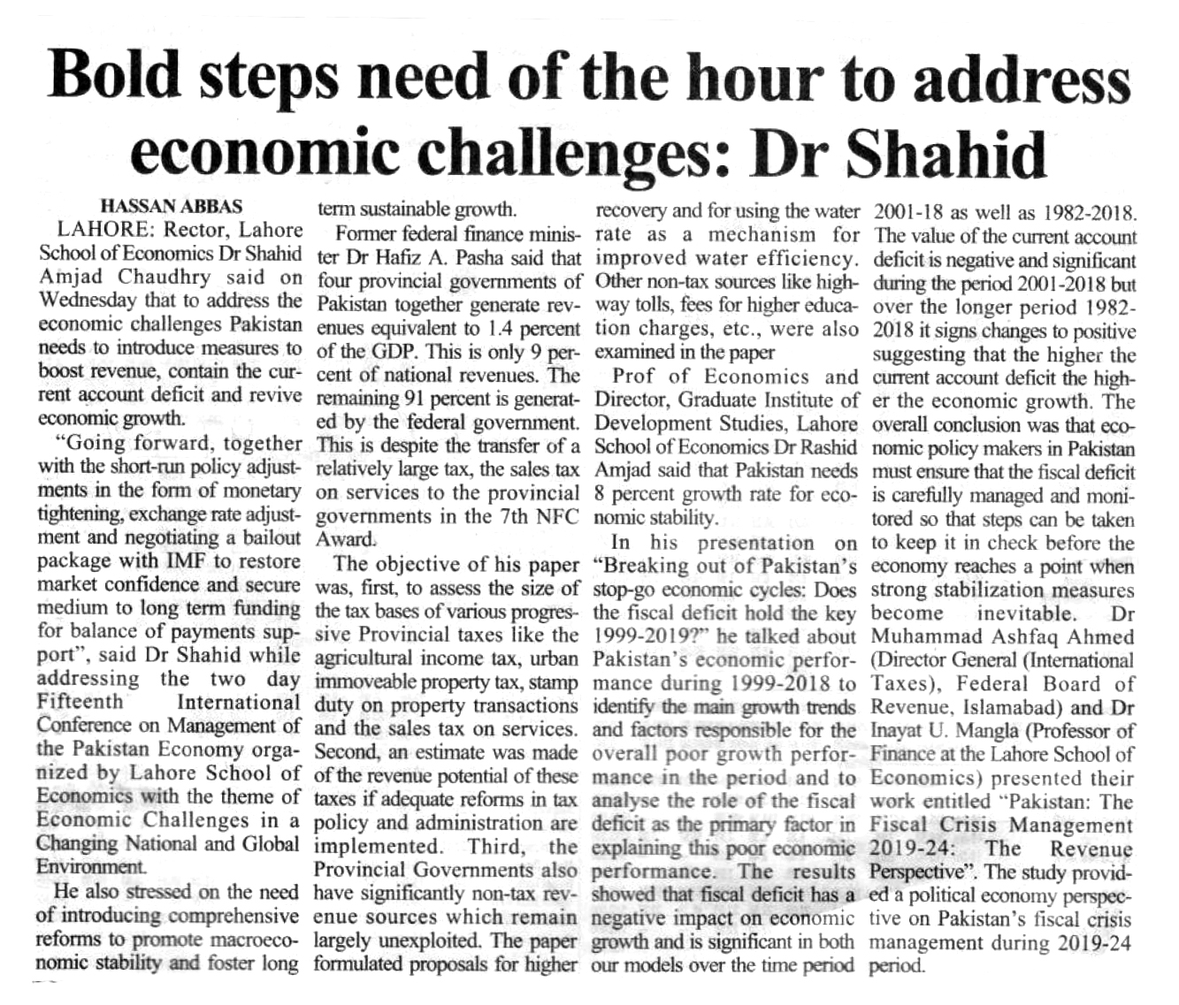
Business Recorder – Page 47 (March 28, 2019

Slide 3
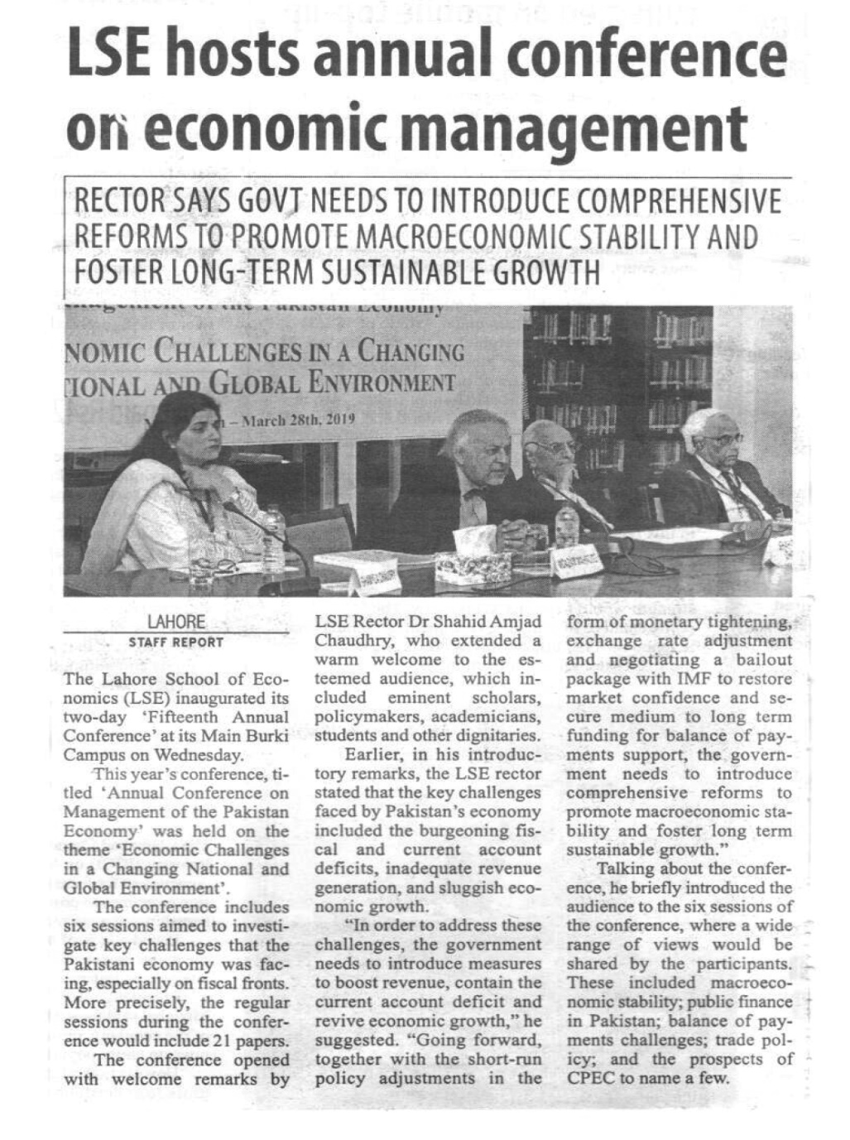
Pakistan Today – Page 12 (March 28, 2019

Slide 4
Daily Times – Page A3 (March 28, 2019

Slide 5
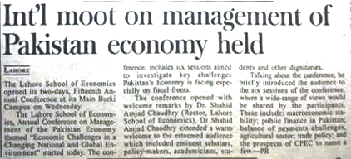
Pakistan Observer – Page 6 (March 28, 2019

Slide 6
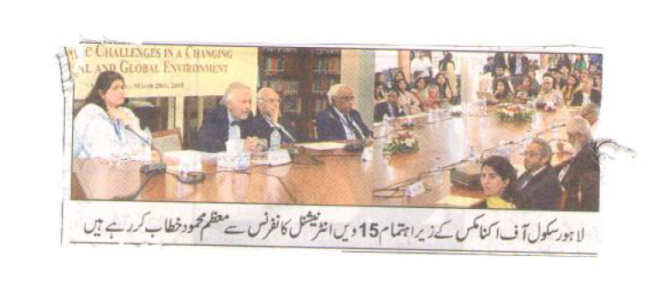
Daily Dunya – Page 9 (March 28, 2019

Slide 7
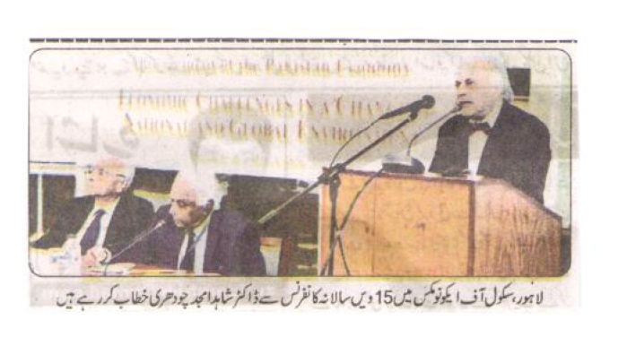
Daily Din – Page 3 (March 28, 2019

Slide 8
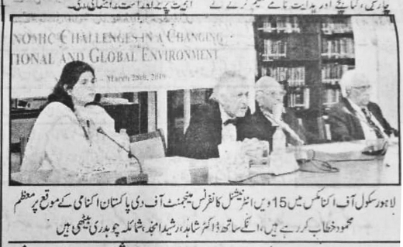
Daily Jinnah – Page 2 (March 28, 2019

Slide 9
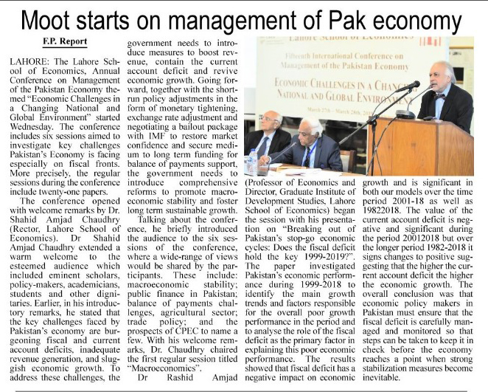
The Frontier Post – Page 12 (March 28, 2019

Slide 10
Thanks…

